Slide 1
Content Finalisation
WP2 T3

Slide 2
Learning Objectives
Create machine-readable metadata in syllabus
Generate overall license
Develop facilitation guide

Slide 3
Agenda
Syllabus metadata
LICENSE
Facilitation Guide

Slide 4
Iterative Process
Iterative development of learning materials
Learning unit by learning unit
Each unit has
Content
Plan
Slide deck
Activities
Quiz
Combine into modules and sections using folders
Following the designed hierarchical structure

Slide 5
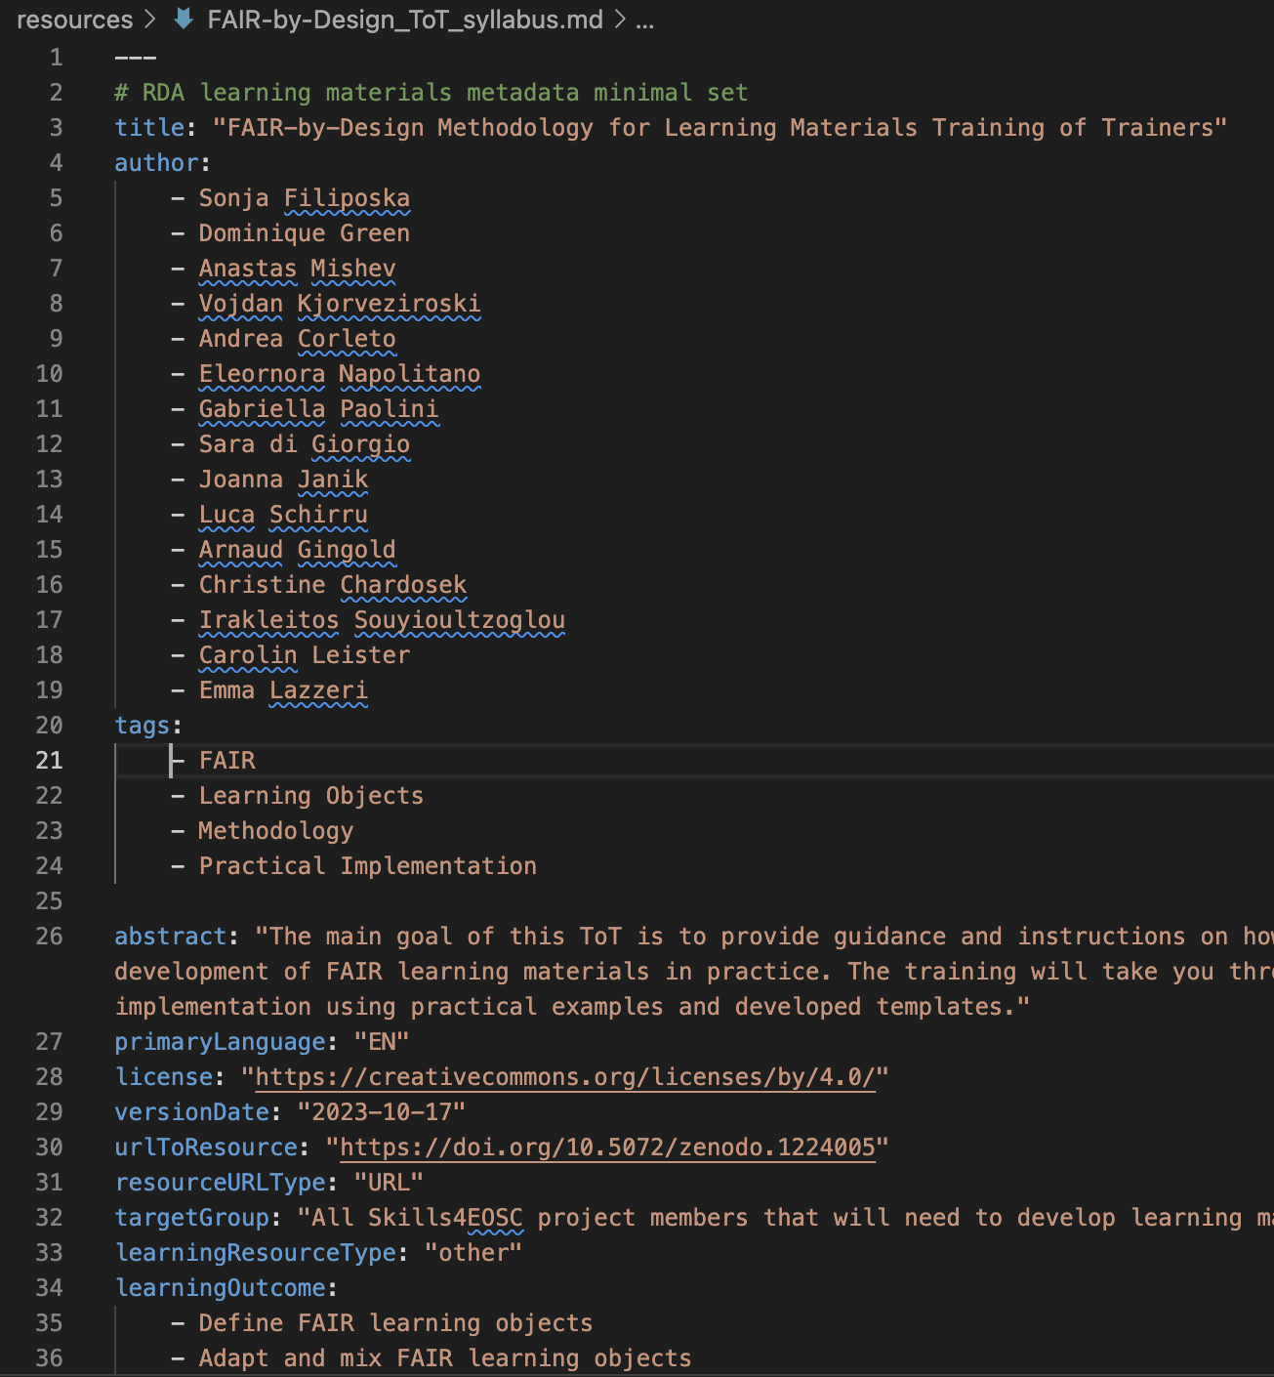
Finalise Syllabus
The initial content was defined in Design
Upon completing the learning units
Update the content
Define the file metadata
YAML syntax
Use the Syllabus.md template
Metadata = Body
Machine-readable version

Slide 6
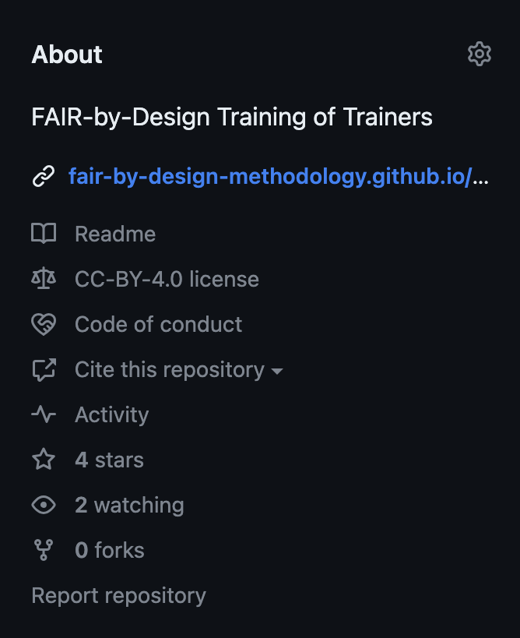
LICENSE (default is CC0)
Find and download the correct plaintext version of your license
Plaintext versions of Creative Commons 4.0 licenses
Open the downloaded legalcode.txt file
Select All and Copy its content
Open the LICENSE file in your repo
Select All and Paste the content of the legalcode.txt overwriting the old content
Save the new content of the LICENSE file
Commit and Push the changes
Go to your repo on GitHub
Check the license information on the right-hand side in About

Slide 7
Facilitation Guide
Introduced in Design
Guiding template available in the Templates repo
template_faciliator_guide.md
Rename and edit
Describe the specifics of the training you are preparing
Looking for inspiration?
facilitation guide prepared for this training

Slide 8
Finalising learning content
Try to:
- update the metadata of the syllabus file
- change the LICENSE

Slide 9
Summary
Expect back-and-forths while developing the learning content
At the final end of the learning content editing stage ensure that
syllabus is up to date
syllabus metadata should reflect the content defined in its body
LICENSE file is as chosen
an overall facilitation guide is available

Slide 10
Thank you! Any questions before we continue?
sonja.filiposka@finki.ukim.mk
Cite instructions on: https://doi.org/10.5281/zenodo.10716172

